Slide 1

Real Estate
Optimizing Profit and Quality

Slide 2

TABLE OF CONTENTS
1
Targets
2
Ames.csv
3
Models
4
Analysis
I describe my target audience/ variables.
How I transformed my data.
Walkthrough of my models.
Compare and keep my best models.

Slide 3

Whats in my data?
Ames.csv
A detailed list of properties of the house
(Is there a kitchen above ground level?)
Kaggle

Slide 4

1
My Targets
Variables and Audiences

Slide 5

What are my target variables?
SalePrice
Price of the house
Overall.Qual
Overall quality of the house

Slide 6
SalePrice
Target Audience?
Real Estate Agents/Realtors
Set prices automatically
Consistent pricing
Common use
Dream house cost
Notes:
First id liek to talk about my first target variable, Sale Price. Sale price as said before is the price of the house. When given

Slide 7
Overall.Qual
Target Audience?
Real Estate Agents/Realtors
Higher quality/Faster sales
More profit
Common use
House Flippers

Slide 8
2
Ames.csv

Slide 9
High Correlation
SalePrice
Overall Quality
Ground floor living area
1st Floor living area
Many more

Slide 10

In what ways did I transform my data?
NA’s
PID & Order
Sale Condition
The data used NA’s to represent “No Pool”
These were Primary Keys
Only normal conditions allowed

Slide 11

Train and Test
I used a 75/25 split

Slide 12
3
My Models

Slide 13
Modeling SalePrice
Important facts I kept in mind
● R-Squared is best
● statistically significant
● Calculate RMSE
Since RMSE is an absolute measure of fit we can compare which model worked best

Slide 14
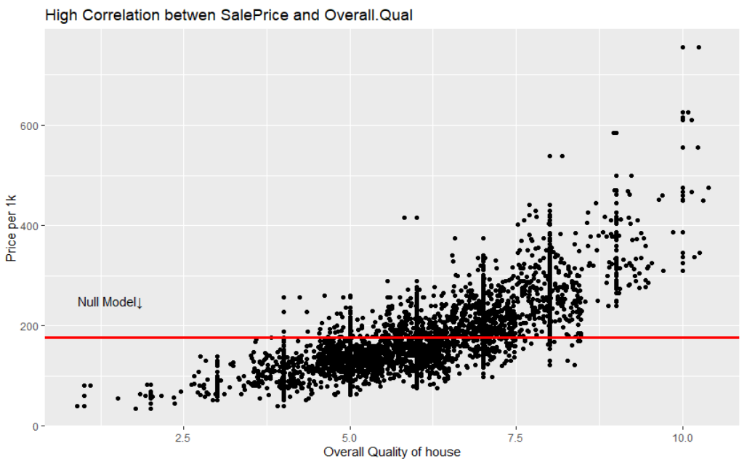
Null Model
Facts about Null Model
● R-Squared = 0
● Statistically insignificant
● RMSE = 1,002,400$
This model is not great as expected. This will only be used to showcase how well the other models do.

Slide 15
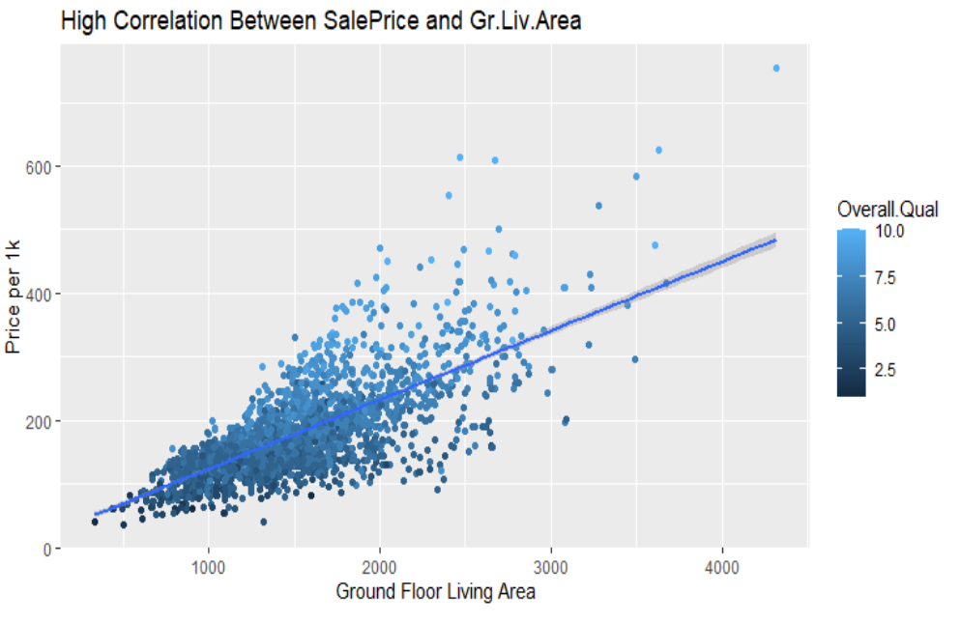
Multiple Regression Model
Facts about Model
● R-Squared = .8522
● Statistically significant
● RMSE =420,900$
Since the RMSE of this model is 1,002,400 - 420,900 = 581,500$ better then the null model, this will be the better model.

Slide 16
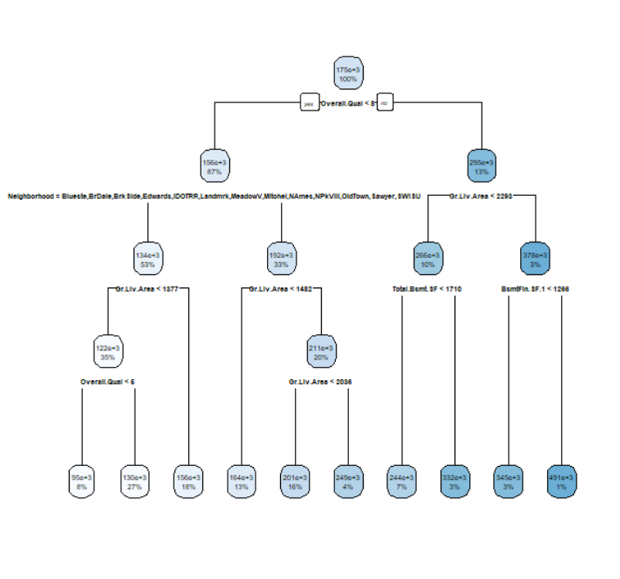
Regression Tree Model
Facts about Model
● R-Squared = ?
● Statistically significant
● RMSE =531,400$
Since the RMSE of this model is 420,900 - 531,400 = -110,500$ worse then the multiple regression model, this will not be a better model.

Slide 17
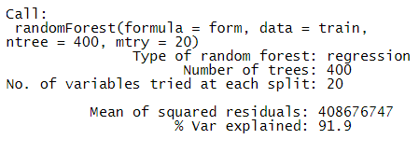
Random Forest Model
Facts about Model
● R-Squared = .919
● Statistically significant
● RMSE =322,200$
Since the RMSE of this model is 420,900 - 322,200 = 98,700$ better then the multiple regression model, this is the best model!

Slide 18
Modeling Overall.Qu
Important facts I kept in mind
● OOB Error/residence deviation is low
● statistically significant
● Calculate accuracy
I will be creating two classes, one for when the overall quality is less than 7 (0) and one for when it isn't (1).

Slide 19
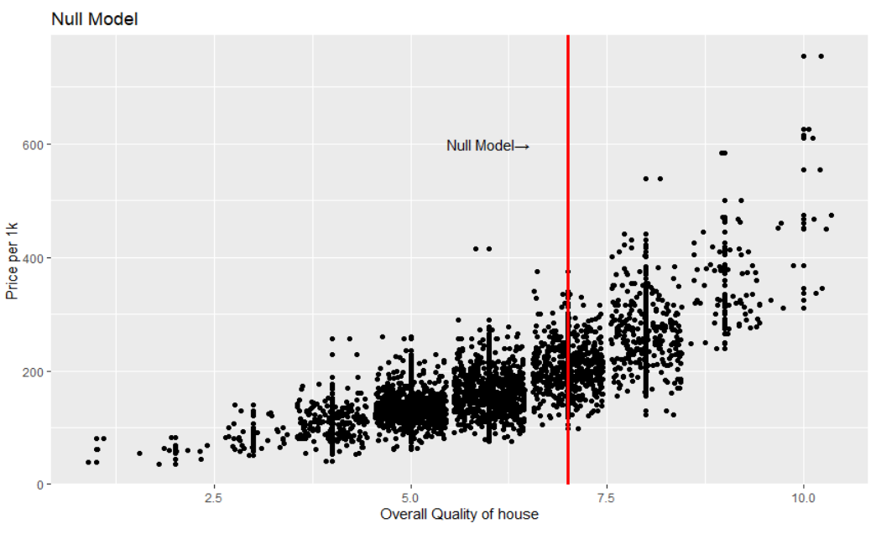
Null Model
Facts about Null Model
● Residual Deviance = 2300
● Statistically insignificant
● Accuracy = 66.78%
This model is not great as expected. This will only be used to showcase how well the other models do.

Slide 20
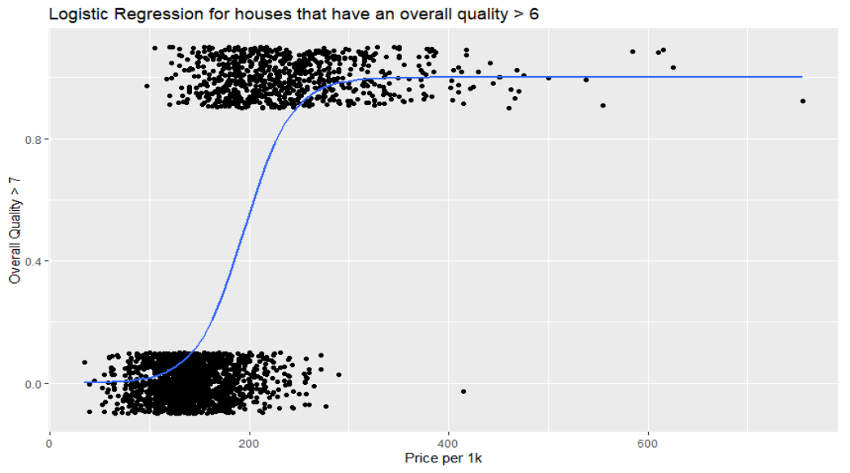
Logistic Regression Classifier
Facts about Classifier
● Residual Deviance = 1146.2
● Statistically significant
● Accuracy = 87.12%
Since the accuracy of this model is 87.12 - 66.78 = 20.34% better then the null model, this will be the better model.

Slide 21
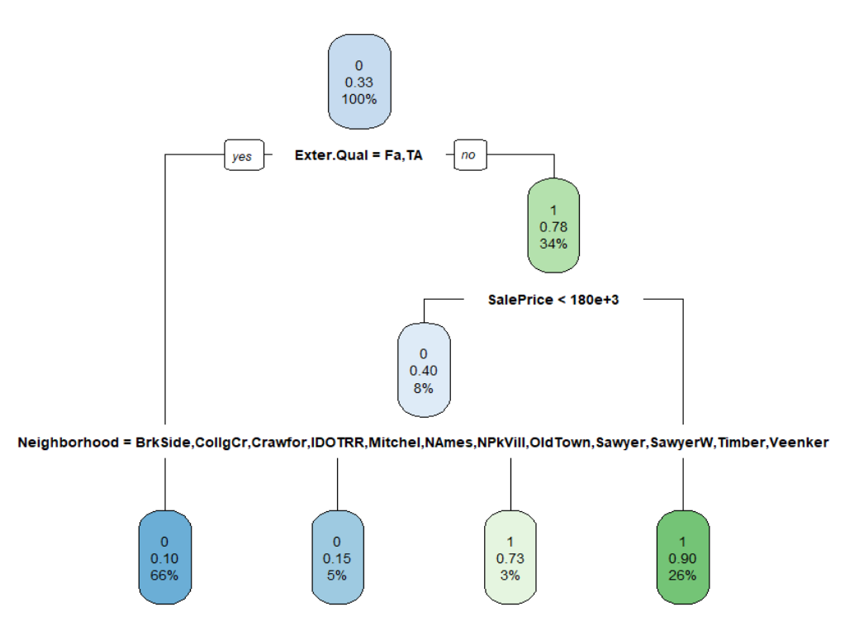
Decision Tree Classifier
Facts about Classifier
● Variance explained = ?
● Statistically significant
● Accuracy = 86.40%
Since the accuracy of this model is 86.40 - 87.12 = -.72% worse than the logistic regression, this will not be the better model.

Slide 22
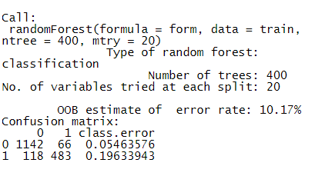
Random Forest Classifier
Facts about Classifier
● OOB error: 10.17%
● Statistically significant
● Accuracy = 89.82%
Since the RMSE of this model is 89.82 - 87.12= 2.7% better then the multiple regression model, this is the best model!

Slide 23
4
Analysis

Slide 24
Compare each Model
Null
Multiple Regression
Regression Tree
Random Forest
● R-Squared = 0
● statistically insignificant
● RMSE = 1,002,400$
● R-Squared = .8522
● Statistically significant
● RMSE =420,900$
● R-Squared = ?
● Statistically significant
● RMSE =531,400$
● R-Squared = .919
● Statistically significant
● RMSE =322,200$

Slide 25
Compare each Classifier
Null
Logistic Regression
Decision Tree
Random Forest
● Residual Deviance = 2300
● Statistically insignificant
● Accuracy = 66.78%
● Residual Deviance = 1146.2
● Statistically significant
● Accuracy = 87.12%
● Variance explained = ?
● Statistically significant
● Accuracy = 86.40%
● OOB error: 10.17%
● Statistically significant
● Accuracy = 89.82%

Slide 26
Validity + Reliabillity
The Random Forest classifier and model was the most accurate and reliable
The reliability of these models are only reliable in Boston. The overall pricing of housing near Boston tends to be higher the closer you are to the city. Yet there was no location attached to this dataset.
To create a more reliable model we would need more information about the location rather then more details about the house.

Slide 27

Questions?

